Slide 1



FOOD AND DRINKS
Anaïs Luthereau
What do you like?

Slide 2


Pour décrire un aliment, je peux utiliser des adjectifs tels que:
yummy / yucky / not very good / delicious /disgusting /
lovely / nice / good / horrible / awful / tasty
nice
good
lovely
tasty
delicious
yummy
not very good
yucky
disgusting
horrible
awful
I like chicken because it is… / I don't like peas because they are…

Slide 3




Pour interroger quelqu’un sur ses goûts tu peux lui demander:
Yes, I do.
Do you like (chips)?
No, I don’t.
What do you like?
I like (chips and chicken) but I don’t like cabbage.
I love (cakes and coke) but I hate beer.

Slide 4

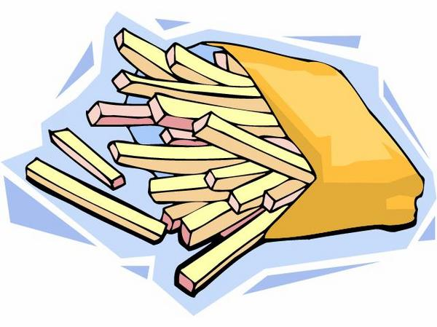
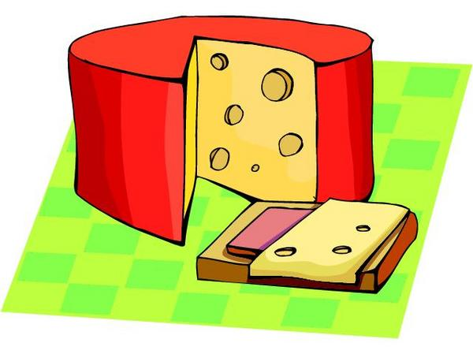
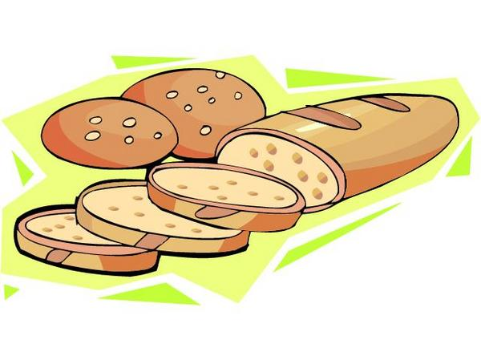
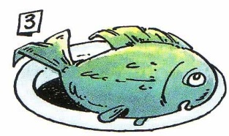








Slide 5
Let’s classify food and drinks!
Drinks (boissons) | fruits | Vegetables (légumes) | Meat (viande)
Dairy products (produits laitiers) | Other food (autres aliments) | Sweets (sucreries) | Junk food (nourriture grasse et peu nutritive,

Slide 6
Utensils
I eat soup out of a plate or out of a ……………………………, with a ………………
I cut meat with a ……………………………
I drink tea out of a ………………………………………………………
In the morning, I drink coffee and milk out of a ……………………………
I drink soda out of a glass or from the ………………………………………………
a bowl
spoon
Eat (manger)
Drink (boire)
Cut (couper)
knife
cup
a bowl
bottle

Slide 7
Pour parler des goûts de quelqu’un
Yes, he does.
she
Does he like (chips)?
she
No, he doesn’t.
she
What does he like?
she
He likes (chips and chicken) but he doesn’t like cabbage.
She loves (cakes and coke) but she hates beer.

Slide 8
